Slide 1
Cold and Flu Self Care
Computer-Based Training
Questions … Please see the Family Health front desk or Pharmacy

Slide 2





If any of the below are true, STOP this training and call
784-APPT (2778) to make an appointment to see a provider.
Note: You do NOT need to be seen by a provider to be put on Quarters.
You can be placed on limited quarters, by your supervisor.
Pregnant/Breastfeeding
PRP/Flying Status
Shortness of breath not due to nasal congestion
Symptoms more than 7 days in duration
Chronic illness:
  Asthma/COPD
  Hypertension (high blood pressure)
  Diabetes
  Heart Disease
Less than 18 years of age
Greater than 55 years of age

Slide 3
Bacterial versus Viral Infections
Bacteria can exist as independent (free-living) microorganisms or as parasites (dependent upon another organism for life).
  Examples of illnesses caused by a bacteria include strep throat, most urinary tract infections, and gonorrhea.
  Bacterial infections ARE treated with antibiotics (penicillin, etc.).
Viruses are microorganisms smaller than a bacteria, which cannot grow or reproduce apart from being inside another living cell.
  Examples of illnesses caused by a virus include the common cold, the flu, HIV/AIDs, and hepatitis.
  Viral infections are NOT treated with an antibiotic … the infection will NOT improve! For the cold/flu, usually only symptoms are treated, and most often with over-the-counter (OTC) medications.

Slide 4
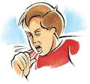
The Common Cold & Flu
A Cold is a viral upper respiratory infection.
  If you have a cold, you will likely have a combination of the following symptoms:
The Flu is also a viral infection.
  You may have some of the same types of symptoms as you would a cold
  With the flu though, you will likely experience a higher fever (greater than 100.5 °F), headache, and muscle aches and pain, especially the lower back and eye muscles, more so than if you have a cold.
Sore throat Runny nose Stuffy/congested nose Stuffy/congested ears Hoarseness | Cough Swollen glands Fever (usually low grade, less than 101°F) e

Slide 5
The Flu
Only in certain circumstances does the flu need to be treated with an antiviral medication.
If you meet any of the below criteria, please contact your provider:
  Severe, complicated or progressive illness(es)
  Higher risk for flu complications:
    Children less than 5 years of age
    Adults 65 years of age or older
    Chronic medical conditions
    Pregnant or postpartum women (2 weeks or less after delivery)
    Persons less than 19 years of age on long-term aspirin therapy
    American Indians and Alaskan Natives
    Morbidly obese (BMI 40 or greater)
  Close contact (i.e., family member) of those groups listed above
If you are a normal healthy individual, you only need to treat your symptoms while your body capably fights off the infection.

Slide 6

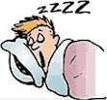
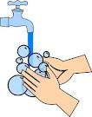
Cold and Flu Treatment
Drink lots of fluids
Get plenty of rest
Blow your nose (makes you feel better! and moves mucus, virus particles, and other allergens outside of the body)
Wash your hands often

Slide 7
Cold/Flu OTC Medicine Treatments
The drugs that are recommended for you to take depend on the symptoms that you are experiencing.
It is very important to read the labels on any OTC medications you get either at the store or even at our pharmacy.
Many OTC medications have multiple ingredients, some of which may be in other medications you are taking or may not even treat the symptoms you are having (which then increases your risk of drug reactions with no benefit).

Slide 8
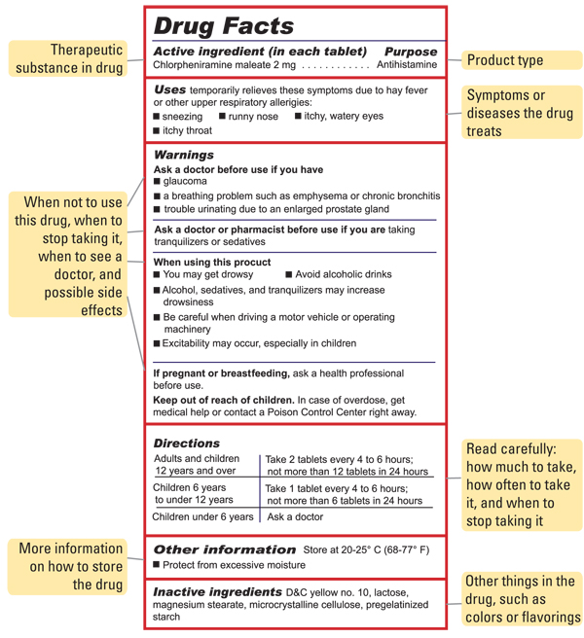
OTC Drug Label Example

Slide 9
Types of OTC Cold/Flu Medications
The following are types of OTC medications used to treat different symptoms of a cold or flu:
  Pain/Fever medications: help decrease pain (body aches, sore throat, headache) and decrease fever; e.g., acetominophen (Tylenol), ibuprofen (Motrin), and naproxen (Aleve). Do not exceed recommended dosages.
  Antihistamines: help treat runny noses, watery eyes, and sneezing.; e.g. diphenhydramine (Benadryl), chlorpheniramine, loratadine (Claritin), certirizine (Zyrtec), and fexofenadine (Allegra). Some may cause drowsiness.
  Decongestants: help relieve nasal congestion (stuffy nose); e.g., pseudoephedrine (Sudafed) and phenylephrine (Sudafed PE).
  Nasal Sprays: help with nasal congestion; e.g., saline nasal spray, oxymetazoline (Afrin). Do not use Afrin for more than 3 consecutive days.
  Expectorants: help to loosen phlegm to make coughs productive and relieve chest congestion; e.g., guaifenesin (Mucinex or Robitussin). Drink plenty of water.
  Cough Suppressants: help to suppress (stop) dry, hacking coughs that prevent sleep, work or are too bothersome; e.g., dextromethorphan (Delsym), dextromethorphan/guaifenesin (Robitussin DM).
  Local Anesthetics: help to numb an area of the body that hurts (i.e. a sore throat); e.g., phenol (Chloroseptic Spray), menthol (N’Ice Lozenges).

Slide 10
Last Words of Advice
Many OTC cold/flu products contain multiple ingredients. Always read the label, especially if you are using multiple products, to make sure you are not taking the same medication/class of medications.
Always follow the directions on the label.
If your symptoms get worse/not getting better within 7 days of onset, you should make an appointment to see your Primary Care Manager (PCM).
Colds and the Flu are contagious! If you don’t have to be at work, you shouldn’t be. Your supervisor can authorize time off for simple illnesses—A QUARTERS SLIP IS NOT REQUIRED. If your supervisor is unsure about this, refer them to your 1st Sergeant or Squadron Commander…they have been briefed on this by the medical staff.

Slide 11
Cold and Flu Self Care Quiz
For each question, you will need to click on the correct answer. If you get the answer right, you will automatically go to the next slide. If you get it wrong you will not be able to go to the next slide and will need to answer correctly before you will be allowed to proceed.
Please go to the next slide when you are ready to begin your 10 question quiz.

Slide 12
A cold is caused by a bacteria.
  True
  False

Slide 13
All of the following are examples of an infection caused by a virus except:
  Flu
  Common Cold
  Strep Throat
  HIV/AIDs

Slide 14
Antibiotics, such as penicillin, will treat a cold or flu.
  True
  False

Slide 15
What is an example of a non-drug therapy for a cold or flu?
  Drink minimal fluids.
  Get plenty of rest.
  Wash your hands only after using the bathroom.
  Sniff your nose instead of blowing it .

Slide 16
All of the following are types of over-the counter (OTC) medications used to treat different cold/flu symptoms except:
  Expectorants
  Decongestants
  Antihistamines
  Penicillin

Slide 17
It is important to use certain nasal sprays, such as Afrin, for no more than how many consecutive days?
  3
  5
  7
  10

Slide 18
What type of symptoms do antihistamines help to treat?
  Dry cough
  Achy body
  Runny nose
  Nasal congestion (stuffy nose)

Slide 19
What do expectorants do?
  Loosen phlegm to make coughs more productive
  Suppress coughs
  Relieve runny noses
  Numb painful areas

Slide 20
Cough suppressants should be used in the following instances except when:
  Cough is productive but not bothersome.
  Cough keeps you up at night.
  Cough becomes too bothersome.
  Cough prevents you from working

Slide 21
How should you take OTC cold/flu medications?
  However you feel like it.
  Twice the amount recommended on the label, especially if symptoms are really bad.
  As directed on the label or by provider.
  Without regard to the combination of ingredients found within various OTC products.

Slide 22
Congratulations!
You have completed the Cold and Flu Self Care CBT. Please print off the certificate on the last slide and bring it to the Pharmacy if you are in need of OTC medications for your cold/flu.

Slide 23
References
Vickery, D.M., Fries, J.F. Take Care of Yourself: The Complete Illustrated Guide to Medical Self-Care, 9th ed. Philadelphia, PA: De Capo Press, 2009.

Slide 24
Certificate of Completion
This is to certify that
Participant’s Name
has completed
The Cold and Flu Self Care
Computer Based Training
This certificate is good for limited cold and flu OTC medications for 6 months from the date below
Pharmacist’s Signature
Date

